Slide 1
Chapter
8
Securing Information Systems

Slide 2
Management Information Systems
Chapter 8 Securing Information Systems
LEARNING OBJECTIVES
Explain why information systems are vulnerable to destruction, error, and abuse.
Assess the business value of security and control.
Identify the components of an organizational framework for security and control.
Evaluate the most important tools and technologies for safeguarding information resources.
Notes:
This chapter discusses the need for security to guard information systems and data as well as technologies used secure information systems. Ask students what types of threats can harm an information system.

Slide 3
Management Information Systems
Chapter 8 Securing Information Systems
Boston Celtics Score Big Points Against Spyware
Problem: Spyware infecting laptops during team travel affecting accessibility and performance of proprietary system
Solutions: Deploy security software to reduce spyware.
Mi5 Network’s Webgate security appliance tool sits between corporate firewall and network to prevent spyware entering network or infected computers connecting to network
Demonstrates IT’s role in combating malicious software
Illustrates digital technology’s role in achieving security on the Web
Notes:
The chapter opening case discusses the problems that spyware caused the Boston Celtics network; spyware that infected coaches, recruiters, and other staff member’s laptops at hotels. Ask students if they have had any personal problems with spyware and to describe this problem. How did they get rid of the spyware?

Slide 4
Management Information Systems
Chapter 8 Securing Information Systems
System Vulnerability and Abuse
Security:
  Policies, procedures and technical measures used to prevent unauthorized access, alteration, theft, or physical damage to information systems
Controls:
  Methods, policies, and organizational procedures that ensure safety of organization’s assets; accuracy and reliability of its accounting records; and operational adherence to management standards
Notes:
This slide introduces the need for both security and controls in today’s businesses in order to safeguard information systems. Ask students to give an example of security technique and an example of a control that might be used in a business.

Slide 5
Management Information Systems
Chapter 8 Securing Information Systems
System Vulnerability and Abuse
Why systems are vulnerable
  Hardware problems
    Breakdowns, configuration errors, damage from improper use or crime
  Software problems
    Programming errors, installation errors, unauthorized changes)
  Disasters
    Power failures, flood, fires, etc.
  Use of networks and computers outside of firm’s control
    E.g., with domestic or offshore outsourcing vendors
Notes:
This slide discusses the main categories of threats to information systems. Note that when large amounts of data are stored digitally, on computers and servers and in databases, they are vulnerable to many more kinds of threats than when they were stored in manual form, on paper in folders and file cabinets. When data are available over a network, there are even more vulnerabilities. Ask students if they have ever lost data on their computers. What was the reason (hardware, software, “disaster,” other people, etc.).

Slide 6
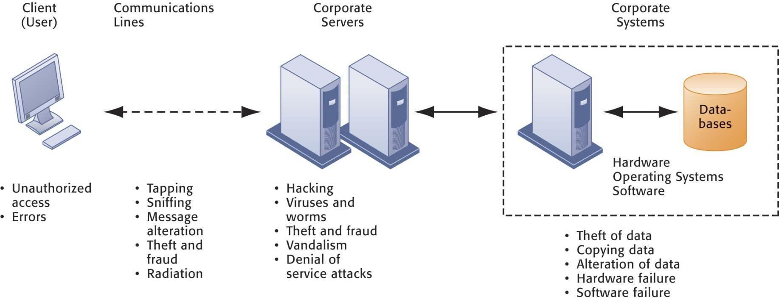
Management Information Systems
Chapter 8 Securing Information Systems
System Vulnerability and Abuse
Contemporary Security Challenges and Vulnerabilities
The architecture of a Web-based application typically includes a Web client, a server, and corporate information systems linked to databases. Each of these components presents security challenges and vulnerabilities. Floods, fires, power failures, and other electrical problems can cause disruptions at any point in the network.
Figure 8-1
Notes:
This graphic illustrates the types of threats to system security and the points over the network at which these threats are prevalent. Some problems occur at the client computer, others through the network lines, corporate servers, or in corporate hardware and software.

Slide 7
Management Information Systems
Chapter 8 Securing Information Systems
System Vulnerability and Abuse
Internet vulnerabilities
  Network open to anyone
  Size of Internet means abuses can have wide impact
  Use of fixed Internet addresses with permanent connections to Internet eases identification by hackers
  E-mail attachments
  E-mail used for transmitting trade secrets
  IM messages lack security, can be easily intercepted
Notes:
This slide discusses the types of threats that large public networks, like the Internet, face because they are open to virtually anyone. Note that Internet is so huge that when abuses do occur, they can have an enormously widespread impact. And when the Internet becomes part of the corporate network, the organization’s information systems are even more vulnerable to actions from outsiders.

Slide 8
Management Information Systems
Chapter 8 Securing Information Systems
System Vulnerability and Abuse
Wireless security challenges
  Radio frequency bands easy to scan
  SSIDs (service set identifiers)
    Identify access points
    Broadcast multiple times
  War driving
    Eavesdroppers drive by buildings and try to intercept network traffic
    When hacker gains access to SSID, has access to network’s resources
  WEP (Wired Equivalent Privacy)
    Security standard for 802.11
    Basic specification uses shared password for both users and access point
    Users often fail to use security features
Notes:
This slide discusses security threats related to wireless networks. Local-area networks (LANs) using the 802.11 standard can be easily penetrated by outsiders armed with laptops, wireless cards, external antennae, and hacking software. Hackers use these tools to detect unprotected networks, monitor network traffic, and, in some cases, gain access to the Internet or to corporate networks. Ask students if they have connected to the Internet through an unknown wireless network that a person or business had established and left unprotected.

Slide 9
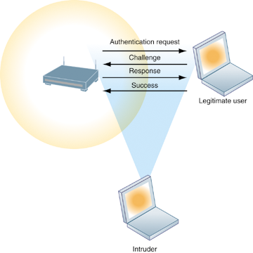
Management Information Systems
Chapter 8 Securing Information Systems
System Vulnerability and Abuse
Wi-Fi Security Challenges
Figure 8-2
Many Wi-Fi networks can be penetrated easily by intruders using sniffer programs to obtain an address to access the resources of a network without authorization.
Notes:
This graphic illustrates why wireless networks are vulnerable - The service set identifiers (SSIDs) identifying the access points in a Wi-Fi network are broadcast multiple times (as illustrated by the orange sphere) and can be picked up fairly easily by intruders’ sniffer programs.

Slide 10
Management Information Systems
Chapter 8 Securing Information Systems
System Vulnerability and Abuse
The Worst Data Theft Ever?
Read the Interactive Session: Organizations and then discuss the following questions:
  List and describe the security control weaknesses at TJX Companies
  What management, organization, and technology factors contributed to these weaknesses?
  What was the business impact of TJX’s data loss on TJX, consumers, and banks?
  How effectively did TJX deal with these problems?
  Who should be held liable for the losses caused by the use of fraudulent credit cards in this case? The banks issuing the cards or the consumers? Justify your answer.
  What solutions would you suggest to prevent the problems?
Notes:
This Interactive Session discusses the massive theft of credit and debit card information from the databases of TJX, a retail company that owns multiple popular retailers such as TJ Maxx and Marshalls. It illustrates how insecure wireless networks can open vulnerabilities to wired networks, and the widespread threats that company systems face.

Slide 11
Management Information Systems
Chapter 8 Securing Information Systems
System Vulnerability and Abuse
Malicious software (malware)
  Viruses: Rogue software program that attaches itself to other software programs or data files in order to be executed
  Worms: Independent computer programs that copy themselves from one computer to other computers over a network
  Trojan horses: Software program that appears to be benign but then does something other than expected
  Spyware: Small programs install themselves surreptitiously on computers to monitor user Web surfing activity and serve up advertising
    Key loggers: Record every keystroke on computer to steal serial numbers, passwords, launch Internet attacks
Notes:
This slide identifies the various types of malware that threaten information systems and computers. Ask students if they have ever had a problem with a virus. Do they know how they got infected?
Note that there are now over 200 viruses and worms targeting mobile phones, and Web 2.0 applications like MySpace and blogs are new conduits for malware and spyware.
Malware is a serious problem - over the past decade, worms and viruses have cause billions of dollars of damage to corporate networks, e-mail systems, and data.

Slide 12
Management Information Systems
Chapter 8 Securing Information Systems
System Vulnerability and Abuse
Various computer crimes:
  Hackers: a person who secretly gets access to a computer system in order to get information, cause damage, etc
  Crackers:A cracker (also known as a black hat hacker) is an individual with extensive computer knowledge whose purpose is to breach or bypass internet security or gain access to software without paying royalties. The general view is that, while hackers build things, crackers break thing
Notes:
This slide looks at the people who commit computer crime, and at the various types of computer crime.
Ask students what the difference is between hackers and crackers and if they agree with the differentiation. Have any students been the victim of computer crime or invasion of privacy?

Slide 13
Management Information Systems
Chapter 8 Securing Information Systems
System Vulnerability and Abuse
Various computer crimes:
Hackers vs. Crackers
A cracker (also known as a black hat hacker) is an individual with extensive computer knowledge whose purpose is to breach or bypass internet security or gain access to software without paying royalties.
The general view is that, while hackers build things, crackers break things.
Cracker is the name given to hackers who break into computers for criminal gain; whereas, hackers can also be internet security experts hired to find vulnerabilities in systems. These hackers are also known as white hat hackers.
Crackers’ motivations can range from profit, a cause they believe in, general maliciousness or just because they like the challenge. They may steal credit card numbers, leave viruses, destroy files or collect personal information to sell.
Notes:
This slide looks at the people who commit computer crime, and at the various types of computer crime.
Ask students what the difference is between hackers and crackers and if they agree with the differentiation. Have any students been the victim of computer crime or invasion of privacy?

Slide 14
Management Information Systems
Chapter 8 Securing Information Systems
System Vulnerability and Abuse
Various computer crimes:
  System intrusion
  Theft of goods and information
  System damage
  Cyber vandals are individuals who damage information infrastructures purely for their own enjoyment and pleasure. Their primary motivation is not financial; it is the desire to prove that the feat could be accomplished. Once inside they leave their mark so there is no denying their presence.
  Cybervandalism
      Intentional disruption, defacement, destruction of Web site or corporate information system
Notes:
This slide looks at the people who commit computer crime, and at the various types of computer crime.
Ask students what the difference is between hackers and crackers and if they agree with the differentiation. Have any students been the victim of computer crime or invasion of privacy?

Slide 15
Management Information Systems
Chapter 8 Securing Information Systems
System Vulnerability and Abuse
Spoofing
  Misrepresenting oneself by using fake e-mail addresses or masquerading as someone else
  Redirecting Web link to address different from intended one, with site masquerading as intended destination
Sniffer: Eavesdropping program that monitors information traveling over network
Denial-of-service attacks (DoS): Flooding server with thousands of false requests to crash the network
Distributed denial-of-service attacks (DDoS): Use of numerous computers to launch a DoS
  Botnets: Networks of “zombie” PCs infiltrated by bot malware
Notes:
This slide continues the discussion of different types of computer crimes. Ask students what the ultimate purpose of spoofing and sniffing are. Note that there are legitimate uses of sniffing – sniffers can help identify network trouble spots or spot criminal activity on a network.
What is the result of a DoS attack?
The text notes that in the first six months of 2007, security product provider Symantec observed over 5 million distinct bot-infected computers. Bots and botnets are an extremely serious threat because they can be used to launch very large attacks using many different techniques.

Slide 16
Management Information Systems
Chapter 8 Securing Information Systems
System Vulnerability and Abuse
Computer crime
  Defined as “any violations of criminal law that involve a knowledge of computer technology for their perpetration, investigation, or prosecution”
  Computer may be target of crime, e.g.:
    Breaching confidentiality of protected computerized data
    Accessing a computer system without authority
  Computer may be instrument of crime, e.g.:
    Theft of trade secrets
    Using e-mail for threats or harassment
Notes:
This slide discusses the legal definition of computer crime and identifies two ways computers can be involved in crime.
The text lists a variety of other examples for computers as targets and as instruments of crime. Ask the students to provide more examples.
According to CSI Computer Crime and Security Survey of nearly 500 companies, participant companies’ average annual loss from computer crime and security attacks was $350,424 (Richardson, 2007). However, many companies are reluctant to report computer crimes. Why? What are the most economically damaging types of computer crime? (DoS, introducing viruses, theft of services, disruption of computer systems.)

Slide 17
Management Information Systems
Chapter 8 Securing Information Systems
System Vulnerability and Abuse
Identity theft: Theft of personal Information (social security id, driver’s license or credit card numbers) to impersonate someone else
Phishing: Setting up fake Web sites or sending e-mail messages that look like legitimate businesses to ask users for confidential personal data.
Evil twins: Wireless networks that pretend to offer trustworthy Wi-Fi connections to the Internet
Pharming: Redirects users to a bogus Web page, even when individual types correct Web page address into his or her browser
Notes:
This slide continues the discussion of types of computer crime.
Have any students encountered any of these types of crimes personally? Note that The U.S. Congress addressed the threat of computer crime in 1986 with the Computer Fraud and Abuse Act. This act makes it illegal to access a computer system without authorization. The text lists other legislation to counter computer crime, such as the National Information Infrastructure Protection Act in 1996 to make virus distribution and hacker attacks to disable Web sites federal crimes.

Slide 18
Management Information Systems
Chapter 8 Securing Information Systems
System Vulnerability and Abuse
Click fraud
  Individual or computer program clicks online ad without any intention of learning more or making a purchase
Global threats - Cyberterrorism and cyberwarfare
  Concern that Internet vulnerabilities and other networks make digital networks easy targets for digital attacks by terrorists, foreign intelligence services, or other groups
Notes:
This slide continues the discussion of types of computer crime. Note that cybercriminal activities are borderless: The global nature of the Internet makes it possible for cybercriminals to operate anywhere in the world.
Ask students if there should be legislation outlawing click fraud.

Slide 19
Management Information Systems
Chapter 8 Securing Information Systems
System Vulnerability and Abuse
Internal threats – Employees
  Security threats often originate inside an organization
    Inside knowledge
    Sloppy security procedures
      User lack of knowledge
    Social engineering:
      Tricking employees into revealing their passwords by pretending to be legitimate members of the company in need of information
Notes:
This slide looks at another source of security problems – people inside the company with access to the system. Ask students if they have ever worked somewhere with a vulnerable password system. Have they ever revealed to anyone what their password is or was?

Slide 20
Management Information Systems
Chapter 8 Securing Information Systems
System Vulnerability and Abuse
Software vulnerability
  Commercial software contains flaws that create security vulnerabilities
    Hidden bugs (program code defects)
      Zero defects cannot be achieved because complete testing is not possible with large programs
    Flaws can open networks to intruders
  Patches
    Vendors release small pieces of software to repair flaws
    However, amount of software in use can mean exploits created faster than patches be released and implemented
Notes:
This slide looks at security and other vulnerabilities caused by software errors that open networks to intruders. The text cites the example of a flawed software upgrade shutting down BlackBerry e-mail service in the U.S. for 12 hours. The cost to the U.S. economy from software flaws runs to nearly $60 billion each year.
Ask students why complete testing is not possible with large programs.
The text gives the example of Microsoft’s service pack upgrades to its operating system software. Service Pack 1 for Vista included security enhancements to counter malware and hackers.

Slide 21
Management Information Systems
Chapter 8 Securing Information Systems
Business Value of Security and Control
Lack of security, control can lead to
  Loss of revenue
    Failed computer systems can lead to significant or total loss of business function
  Lowered market value:
    Information assets can have tremendous value
    A security breach may cut into firm’s market value almost immediately
  Legal liability
  Lowered employee productivity
  Higher operational costs
Notes:
This slide looks at the value of security and control to the business. Ask students what types of data have tremendous value or require protection. The text gives the examples of individual confidential information (taxes, finances, medical records, job performance reviews) and high-value data (trade secrets, new product development, marketing strategies, government information).
Ask students to give an example of how inadequate security or control can pose a serious legal liability. The text gives the example of BJ’s Wholesale Club which was sued by the U.S. Federal Trade Commission for allowing hackers to access its systems and steal credit and debit card data for fraudulent purchase.

Slide 22
Management Information Systems
Chapter 8 Securing Information Systems
Business Value of Security and Control
Legal and regulatory requirements for electronic records management
  Firms face new legal obligations for the retention and storage of electronic records as well as for privacy protection
  HIPAA: Medical security and privacy rules and procedures
  Gramm-Leach-Bliley Act: Requires financial institutions to ensure the security and confidentiality of customer data
  Sarbanes-Oxley Act: Imposes responsibility on companies and their management to safeguard the accuracy and integrity of financial information that is used internally and released externally
Notes:
This slide continues the look at the business value of security and control, examining the legal requirements for electronic records management.
Note that the Sarbanes-Oxley Act was designed to protect investors after the scandals at Enron, WorldCom, and other public companies. Sarbanes-Oxley is fundamentally about ensuring that internal controls are in place to govern the creation and documentation of information in
financial statements. Because managing this data involves information systems, information systems must implement controls to make sure this information is accurate and to enforce integrity, confidentiality, and accuracy.

Slide 23
Management Information Systems
Chapter 8 Securing Information Systems
Business Value of Security and Control
Electronic evidence
  Evidence for white collar crimes often found in digital form
  Data stored on computer devices, e-mail, instant messages, e-commerce transactions
Proper control of data can save time, money when responding to legal discovery request
Computer forensics:
  Scientific collection, examination, authentication, preservation, and analysis of data from computer storage media for use as evidence in court of law
  Includes recovery of ambient and hidden data
Notes:
This slide continues the discussion of the business value of security and control. Security, control, and electronic records management are essential today for responding to legal actions. Ask students what the most common form of electronic evidence is (e-mail).
Note that in a legal action, a firm is obligated to respond to a discovery request for access to information that may be used as evidence, and the company is required by law to produce those data. The cost of responding to a discovery request can be enormous if the company has trouble assembling the required data or the data have been corrupted or destroyed. Courts impose severe financial and even criminal penalties for improper destruction of electronic documents.
Ask students what ambient data is and to give an example.
Given the legal requirements for electronic records, it is important that an awareness of computer forensics should be incorporated into a firm’s
contingency planning process.

Slide 24
Management Information Systems
Chapter 8 Securing Information Systems
Establishing a Framework for Security and Control
Information systems controls
  General controls
    Govern design, security, and use of computer programs and data throughout organization’s IT infrastructure
    Combination of hardware, software, and manual procedures to create overall control environment
    Types of general controls
      Software controls
      Hardware controls
      Computer operations controls
      Data security controls
      Implementation controls
      Administrative controls
Notes:
To improve security for a firm’s information systems, it is important to create a framework that supports security. This includes establishing information systems controls, understanding the risks to the firm’s information systems, and establishing security policies that are appropriate for the firm. This slide looks at controls used in information systems. Remember that controls are methods, policies, and organizational procedures that ensure safety of organization’s assets; accuracy and reliability of its accounting records; and operational adherence to management standards. There are two main types of controls, general controls and application controls. General controls apply to all computerized applications.
Ask students what the functions are of the different types of general controls.

Slide 25
Management Information Systems
Chapter 8 Securing Information Systems
Establishing a Framework for Security and Control
Application controls
  Specific controls unique to each computerized application, such as payroll or order processing
  Include both automated and manual procedures
  Ensure that only authorized data are completely and accurately processed by that application
  Types of application controls:
    Input controls
    Processing controls
    Output controls
Notes:
This slide examines the second type of information systems controls, application controls.
Ask students what each type of application control does. (Input controls check data for accuracy and completeness when they enter the system. There are specific input controls for input authorization, data conversion, data editing, and error handling. Processing controls establish that data are complete and accurate during updating. Output controls ensure that the results of computer processing are accurate, complete, and properly distributed.)

Slide 26
Management Information Systems
Chapter 8 Securing Information Systems
Establishing a Framework for Security and Control
Risk assessment
  Determines level of risk to firm if specific activity or process is not properly controlled
    Types of threat
    Probability of occurrence during year
    Potential losses, value of threat
    Expected annual loss
EXPOSURE | PROBABILITY | LOSS RANGE (AVERAGE) | EXPECTED ANNUAL LOSS
Power failure | 30% | $5K - $200K ($102,500) | $30,750
Embezzlement | 5% | $1K - $50K ($25,500) | $1,275
User error | 98% | $200 - $40K ($20,100) | $19,698
Notes:
This slide looks at another important factor in establishing an appropriate framework for security and control, risk assessment. While not all risks can be anticipated and measured, most businesses should be able identify many of the risks they face.
The table illustrates sample results of a risk assessment for an online order processing system that processes 30,000 orders per day. The likelihood of each exposure occurring over a one-year period is expressed as a percentage. The expected annual loss is the result of multiplying the probability by the average loss.
Ask students to rank the three risks listed here in order of most important to minimize.

Slide 27
Management Information Systems
Chapter 8 Securing Information Systems
Establishing a Framework for Security and Control
Security policy
  Ranks information risks, identifies acceptable security goals, and identifies mechanisms for achieving these goals
  Drives other policies
    Acceptable use policy (AUP): Defines acceptable uses of firm’s information resources and computing equipment
    Authorization policies: Determine differing levels of user access to information assets
Authorization management systems
  Allow each user access only to those portions of system that person is permitted to enter, based on information established by set of access rules, profile
Notes:
This slide looks at the need for a firm to establish a security policy for protecting a company’s assets, as well as other company policies the security policy drives, and how information systems support this. The text provides the example of the security policy at Unilever, a multinational consumer goods company, which requires every employee with a laptop or mobile handheld to use an approved device and employ a password or other method of identification when logging onto the corporate network.
Ask students what types of issues would be covered under an AUP. (Privacy, user responsibility, and personal use of company equipment and networks, unacceptable and acceptable actions for every user and consequences for noncompliance.)

Slide 28
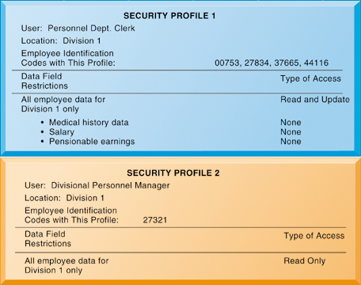
Management Information Systems
Chapter 8 Securing Information Systems
Establishing a Framework for Security and Control
Security Profiles for a Personnel System
Figure 8-3
These two examples represent two security profiles or data security patterns that might be found in a personnel system. Depending on the security profile, a user would have certain restrictions on access to various systems, locations, or data in an organization.
Notes:
This graphic illustrates the security allowed for two sets of users of a personnel database that contains sensitive information such as employees’ salaries and medical histories. Divisional managers cannot update the system but can read all employee data fields for his or her division, including medical history and salary. Clerical employees who input employee data into the system can update the system but can neither read nor
update sensitive fields. These security profiles are based on access rules supplied by business groups in the firm.

Slide 29
Management Information Systems
Chapter 8 Securing Information Systems
Establishing a Framework for Security and Control
Disaster recovery planning: Devises plans for restoration of disrupted services
Business continuity planning: Focuses on restoring business operations after disaster
Both types of plans needed to identify firm’s most critical systems and business processes
  Business impact analysis to determine impact of an outage
  Management must determine
    Maximum time systems can be down
    Which systems must be restored first
Notes:
This slide continues the discussion of essential activities a firm performs to maximize security and control, here looking at planning for activities should a disaster occur, such as a flood, earthquake, or power outage. Note that disaster recovery plans focus primarily on the technical issues involved in keeping systems up and running, such as which files to back up and the maintenance of backup computer systems or disaster recovery services. The text provides the example of MasterCard, which maintains a duplicate computer center in Kansas City, Missouri, to serve as an emergency backup to its primary computer center in St. Louis.
Ask students why it is important that both business managers and information systems specialists work together on these plans.

Slide 30
Management Information Systems
Chapter 8 Securing Information Systems
Establishing a Framework for Security and Control
MIS audit
  Examines firm’s overall security environment as well as controls governing individual information systems
  Reviews technologies, procedures, documentation, training, and personnel
  May even simulate disaster to test response of technology, IS staff, other employees
  Lists and ranks all control weaknesses and estimates probability of their occurrence
  Assesses financial and organizational impact of each threat
Notes:
This slide looks at the role of auditing. An MIS audit enables a firm to determine if existing security measures and controls are effective.

Slide 31
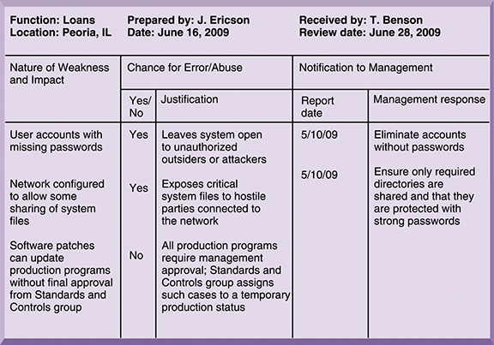
Management Information Systems
Chapter 8 Securing Information Systems
Establishing a Framework for Security and Control
Sample Auditor’s List of Control Weaknesses
Figure 8-4
This chart is a sample page from a list of control weaknesses that an auditor might find in a loan system in a local commercial bank. This form helps auditors record and evaluate control weaknesses and shows the results of discussing those weaknesses with management, as well as any corrective actions taken by management.
Notes:
This graphic illustrates a sample page from an auditor’s listing of control weaknesses for a loan system. It includes a section for notifying management of such weaknesses and for management’s response. Management is expected to devise a plan for countering significant weaknesses in controls

Slide 32
Management Information Systems
Chapter 8 Securing Information Systems
Technologies and Tools for Security
Access control: Policies and procedures to prevent improper access to systems by unauthorized insiders and outsiders
  Authorization
  Authentication
    Password systems
    Tokens
    Smart cards
    Biometric authentication
Notes:
This slide begins a look at the technologies and tools an organization can use to secure systems and data, ensure system availability, and ensure data quality. Here, techniques for preventing unauthorized access to a system are listed. Ask students what the difference between authentication and authorization is. Have any students used authentication methods other than passwords to access a system?

Slide 33
Management Information Systems
Chapter 8 Securing Information Systems
Technologies and Tools for Security
Firewall: Hardware and/or software to prevent unauthorized access to private networks
  Screening technologies
    Packet filtering
    Stateful inspection
    Network address translation (NAT)
    Application proxy filtering
Intrusion detection systems: Monitor vulnerable points on networks to detect and deter intruders
  Examines events as they are happening to discover attacks in progress
  Scans network to find patterns indicative of attacks
Notes:
This slide looks at two methods to prevent intruders from accessing private networks. To create a strong firewall, an administrator must maintain detailed internal rules identifying the people, applications, or addresses that are allowed or rejected. Firewalls can deter, but not completely prevent, network penetration by outsiders and should be viewed as one element in an overall security plan.
Ask students to differentiate between the screening technologies listed here. Note that these are often used in combination. Ask students if they use firewall software on their own computers.

Slide 34
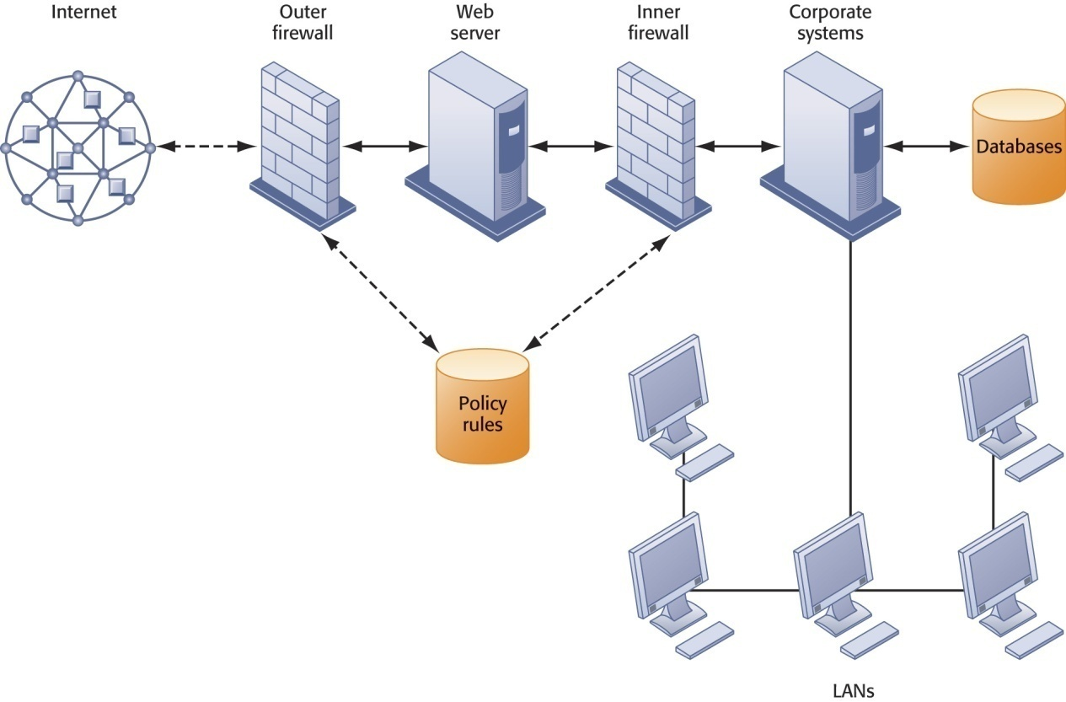
Management Information Systems
Chapter 8 Securing Information Systems
Technologies and Tools for Security
A Corporate Firewall
The firewall is placed between the firm’s private network and the public Internet or another distrusted network to protect against unauthorized traffic.
Figure 8-5
Notes:
This graphic illustrates the use of firewalls on a corporate network. Notice that here, a second, “inner” firewall protects the Web server from access through the internal network.

Slide 35
Management Information Systems
Chapter 8 Securing Information Systems
Technologies and Tools for Security
Antivirus and antispyware software:
  Checks computers for presence of malware and can often eliminate it as well
  Require continual updating
Unified threat management (UTM)
  Comprehensive security management products
  Tools include
    Firewalls
    Intrusion detection
    VPNs
    Web content filtering
    Antispam software
Notes:
This slide looks at additional tools to prevent unwanted intruders and software from accessing the network. Ask students what antivirus and antispyware tools they use. Ask why these tools require continual updating. Ask why UTM packages would include antispam software.

Slide 36
Management Information Systems
Chapter 8 Securing Information Systems
Technologies and Tools for Security
Securing wireless networks
  WEP security can be improved:
    Activating it
    Assigning unique name to network’s SSID
    Using it with VPN technology
  Wi-Fi Alliance finalized WAP2 specification, replacing WEP with stronger standards
    Continually changing keys
    Encrypted authentication system with central server
Notes:
This slide looks at the tools and technologies used to secure wireless networks. Ask students with laptops what types of wireless security they have.

Slide 37
Management Information Systems
Chapter 8 Securing Information Systems
Technologies and Tools for Security
Encryption:
  Transforming text or data into cipher text that cannot be read by unintended recipients
  Two methods for encrypting network traffic
    Secure Sockets Layer (SSL) and successor Transport Layer Security (TLS)
    Secure Hypertext Transfer Protocol (S-HTTP)
  Two methods of encryption
    Symmetric key encryption
    Public key encryption
Notes:
This slide discusses the use of encryption to ensure that data traveling along networks cannot be read by unauthorized users. Ask students to explain the difference between symmetric key encryption and public key encryption. (In symmetric key encryption, the sender and receiver establish a secure Internet session by creating a single encryption key and sending it to the receiver so both the sender and receiver share the same key. Public key encryption uses two keys: one shared (or public) and one totally private. The keys are mathematically related so that data encrypted with one key can be decrypted using only the other key. To send and receive messages, communicators first create separate pairs of private and public keys. The public key is kept in a directory and the private key must be kept secret. The sender encrypts a message with the recipient’s public key. On receiving the message, the recipient uses his or her private key to decrypt it.
Ask students why public key encryption is stronger than symmetric key encryption.
Note that the strength of an encryption key is measured by its bit length. Today, a typical key will be 128 bits long (a string of 128 binary digits).

Slide 38
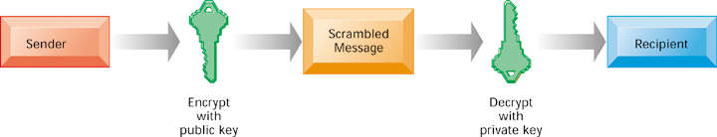
Management Information Systems
Chapter 8 Securing Information Systems
Technologies and Tools for Security
Public Key Encryption
A public key encryption system can be viewed as a series of public and private keys that lock data when they are transmitted and unlock the data when they are received. The sender locates the recipient’s public key in a directory and uses it to encrypt a message. The message is sent in encrypted form over the Internet or a private network. When the encrypted message arrives, the recipient uses his or her private key to decrypt the data and read the message.
Figure 7-6
Notes:
This graphic illustrates the steps in public key encryption. The sender encrypts data using the public key of the recipient; data encrypted with this public key can only be decrypted with the recipient’s private key.

Slide 39
Management Information Systems
Chapter 8 Securing Information Systems
Technologies and Tools for Security
Digital certificate:
  Data file used to establish the identity of users and electronic assets for protection of online transactions
  Uses a trusted third party, certification authority (CA), to validate a user’s identity
  CA verifies user’s identity, stores information in CA server, which generates encrypted digital certificate containing owner ID information and copy of owner’s public key
Public key infrastructure (PKI)
  Use of public key cryptography working with certificate authority
  Widely used in e-commerce
Notes:
This slide looks at the use of digital certificates as a tool to help protect online transactions. Digital certificates are used in conjunction with public key encryption to validate the identities of two parties in a transaction before data is exchanged.

Slide 40
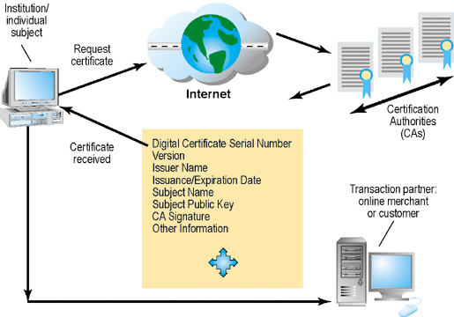
Management Information Systems
Chapter 8 Securing Information Systems
Technologies and Tools for Security
Digital Certificates
Figure 8-7
Digital certificates help establish the identity of people or electronic assets. They protect online transactions by providing secure, encrypted, online communication.
Notes:
This graphic illustrates the process for using digital certificates. The institution or individual requests a certificate over the internet from a CA; the certificate received from the CA can then be used to validate a transaction with an online merchant or customer.

Slide 41
Management Information Systems
Chapter 8 Securing Information Systems
Technologies and Tools for Security
Ensuring system availability
  Online transaction processing requires 100% availability, no downtime
  Fault-tolerant computer systems
    For continuous availability
    Contain redundant hardware, software, and power supply components to provide continuous, uninterrupted service
  High-availability computing
    Helps recover quickly from crash
    Minimizes, does not eliminate downtime
Notes:
This slide and the next look at technologies and tools for ensuring system availability. Ask students why online transaction processing requires 100% availability.
Note that firms with heavy e-commerce processing or for firms that depend on digital networks for their internal operations require at minimum high-availability computing, using tools such as backup servers, distribution of processing across multiple servers, high-capacity
storage, and good disaster recovery and business continuity plans.

Slide 42
Management Information Systems
Chapter 8 Securing Information Systems
Technologies and Tools for Security
Recovery-oriented computing
  Designing systems that recover quickly with capabilities to help operators pinpoint and correct of faults in multi-component systems
Controlling network traffic
  Deep packet inspection (DPI)
Security outsourcing
  Managed security service providers (MSSPs)
Notes:
This slide continues the discussion of techniques to minimize downtime and improve network performance. Deep packet inspection enables a network to sort low-priority data packets from high-priority ones in order to improve performance for business critical communication. Ask students what types of network traffic would be suitable for assigning lower priority in a business setting?

Slide 43
Management Information Systems
Chapter 8 Securing Information Systems
Technologies and Tools for Security
Can Salesforce.com On-Demand Remain in Demand?
Read the Interactive Session: Technology and then discuss the following questions:
  How did the problems experienced by Salesforce.com impact its business?
  How did the problems impact its customers?
  What steps did Salesforce.com take to solve the problems? Were these steps sufficient?
  List and describe other vulnerabilities discussed in this chapter that might create outages at Salesforce.com and measures to safeguard against them.
Notes:
This Interactive Session discusses the consequences outages in Salesforce.com software that prevented clients from accessing the system, once for more than three hours. This case illustrates the serious consequences of problems in software and hardware quality, and the technologies that can be used to maximize system availability.

Slide 44
Management Information Systems
Chapter 8 Securing Information Systems
Technologies and Tools for Security
Ensuring software quality
  Software Metrics: Objective assessments of system in form of quantified measurements
    Number of transactions
    Online response time
    Payroll checks printed per hour
    Known bugs per hundred lines of code
  Testing: Early and regular testing
    Walkthrough: Review of specification or design document by small group of qualified people
    Debugging: Process by which errors are eliminated
Notes:
This slide looks at ensuring software quality as a way to improve system quality and reliability by employing software metrics and rigorous software testing. Ongoing use of metrics allows the information systems department and end users to jointly measure the
performance of the system and identify problems as they occur.

Slide 45

All rights reserved. No part of this publication may be reproduced, stored in a retrieval system, or transmitted, in any form or by any means, electronic, mechanical, photocopying, recording, or otherwise, without the prior written permission of the publisher. Printed in the United States of America.
Copyright © 2010 Pearson Education, Inc.
Publishing as Prentice Hall

